Slide 1
Jira integration in Testomatio
User Stories, Tests, Runs
Agoda – Booking hotels and air tickets
https://www.agoda.com/

Slide 2
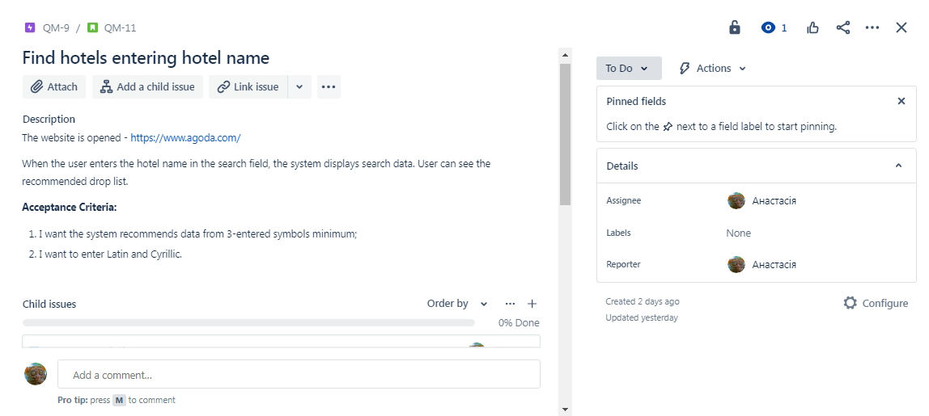
User Story “Find hotels entering hotel name”

Slide 3
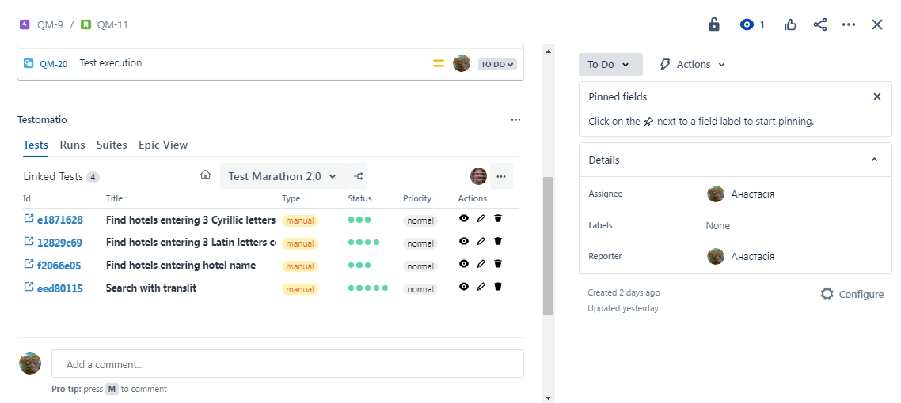
Test

Slide 4
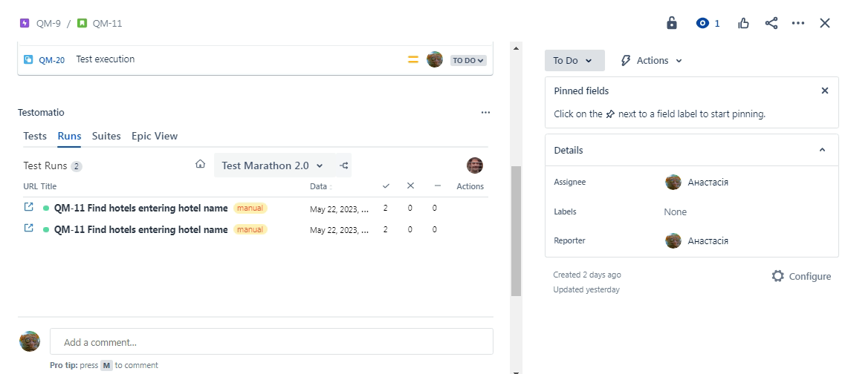
Run

Slide 5
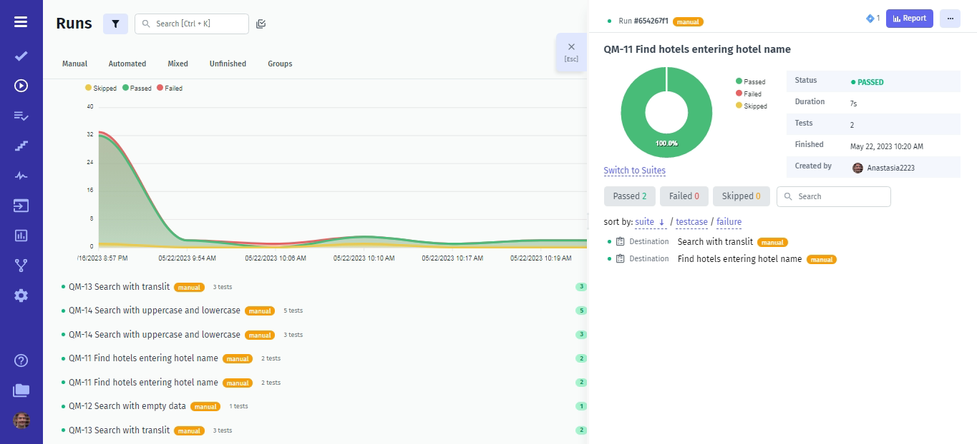
Copy link to see the report - https://app.testomat.io/report/654267f1/19d96af9-18b1-46d5-b8a0-d323c4bb198d

Slide 6
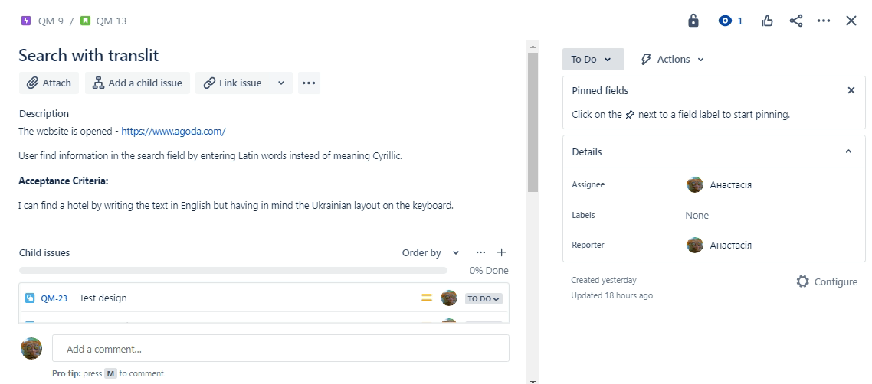
User Story “Search with translit”

Slide 7
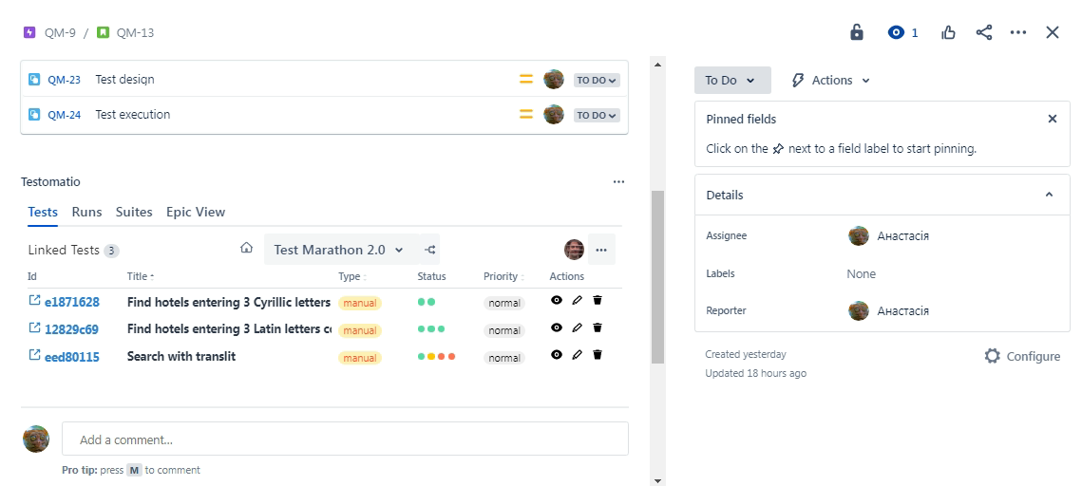
Test

Slide 8
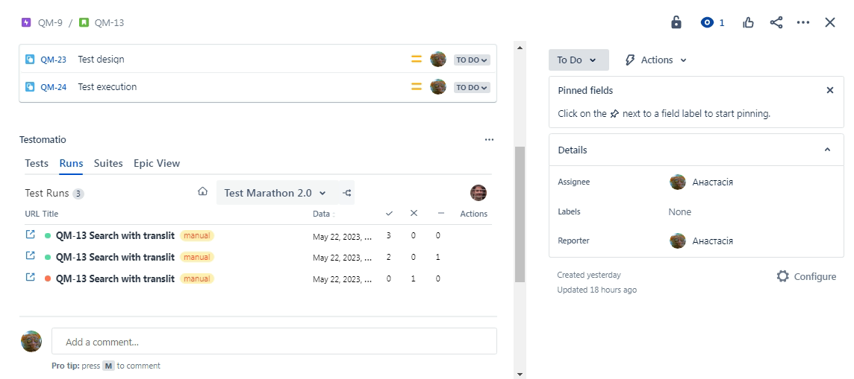
Run

Slide 9
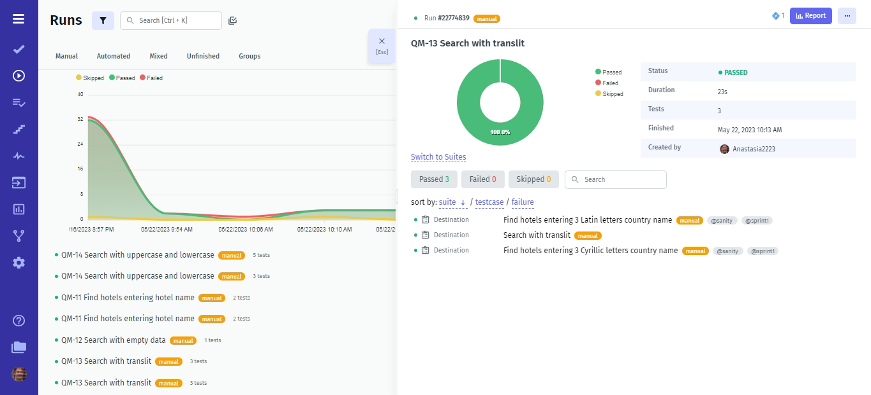
Copy link to see the report https://app.testomat.io/report/22774839/43219019-7af1-4db9-9f66-e0080862f24b

Slide 10
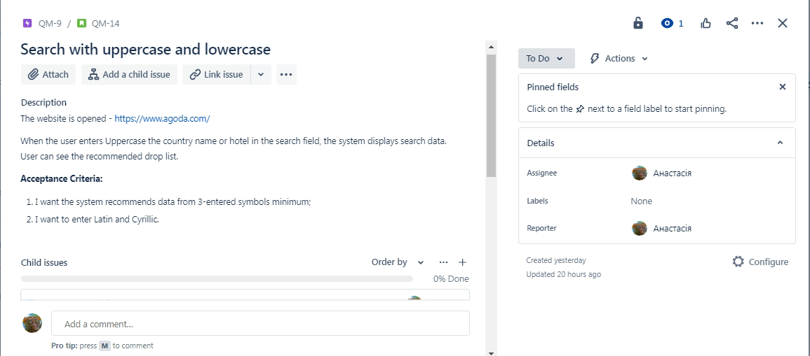
User Story “Search with uppercase & lowercase”

Slide 11
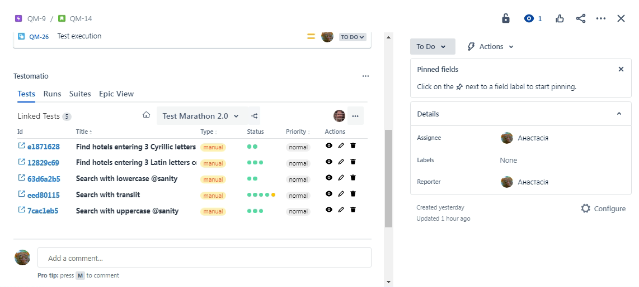
Test

Slide 12
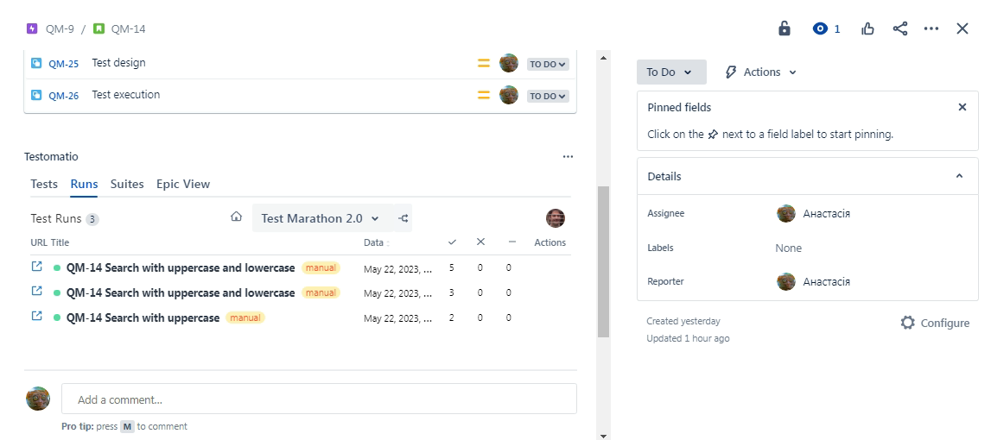
Run

Slide 13
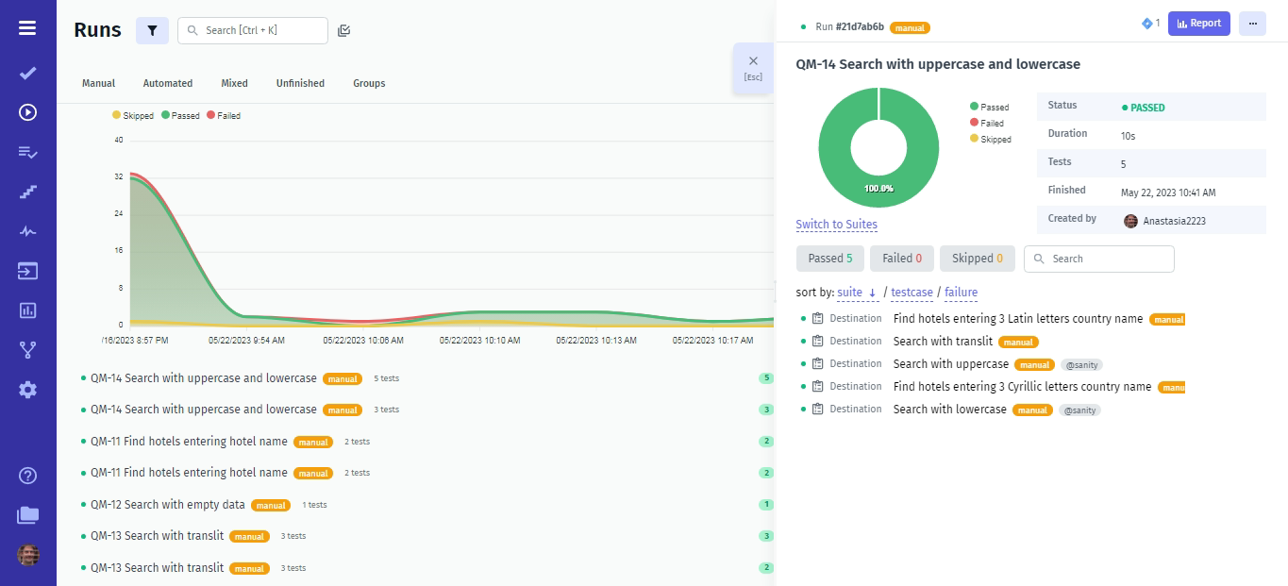
Copy link to see the report https://app.testomat.io/report/21d7ab6b/8d4a2588-5407-4efc-a118-747b0e83aeae

